Slide 1
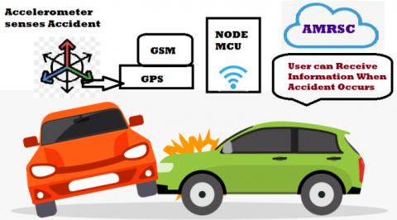
Automatic Vehicle Accident Detection and Messaging System Using GSM and GPS Module
Presented by
211FA05089-K.SATISH BABU
211FA05097-Y.UMA MAHESH
211FA05109-M.HARI VARDHAN
211FA05229-P.SAI TEJA
Under the guidance of
DR.LAKSHMI SRINIVAS

Slide 2
CONTENTS
Objective
Abstract
Introduction
Existing methods
Limitations of Existing methods
Proposed system
Working principle
Advantages
Applications
Result
References

Slide 3
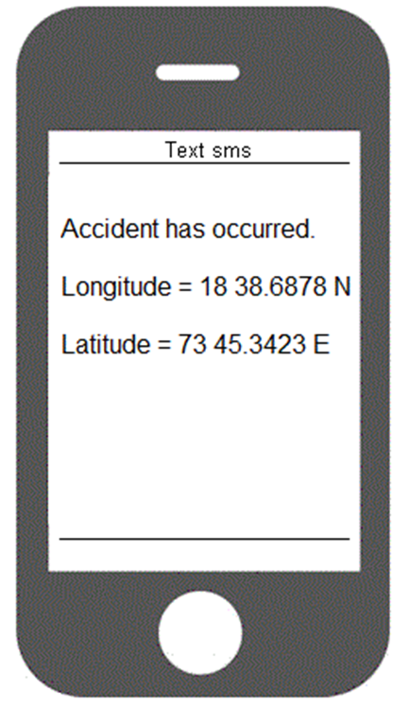
Objective
To send an alert message to the pre-coded number through GSM module.
To find the location of an accident where it was Detected
By using GPS module.

Slide 4
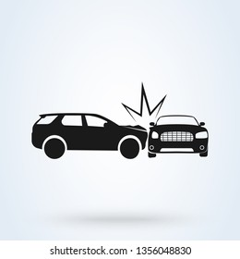
Introduction
In today’s world as the population increases day by day the numbers of vehicle also increases on the road and highways. This results in accident that leads to the traffic jams and people do not get the help instantaneously. Road accidents constitute the major part of the accident deaths all over the world . This takes a toll on the property as well as causes human life loss because of unavailability of immediate safety facilities.

Slide 5
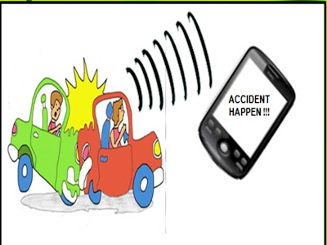
Abstract
The purpose of the project is to find the accident location using GPS module and to send this location by means of sending a message using GSM module to the pre-coded number.
With the advancement in technology and cost coming down, in our project we attempt to build similar device for our cars, not only this device will help us in post-crash analysis but also it will help us in quicker emergency rescue operation.

Slide 6
Existing methods
There are many solutions proposed for the concerned problem and each one have some advantage over others.
Presently tracking system is introduced in vehicles to avoid accidents and save people’s life.
They have used microcontroller for this purpose. But the existing systems are available only in high-end vehicles, because the monitoring system is expensive.

Slide 7
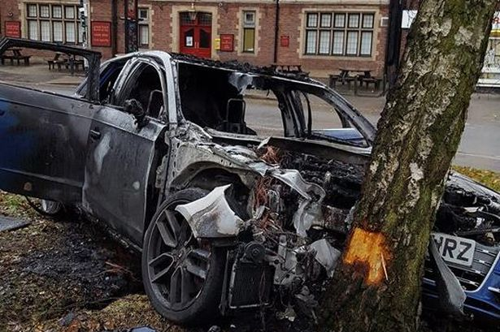
Limitations of Existing methods
The live system can’t work if any of the following occur at the time of the crash:
phone is disconnected or damaged.
No GPS signal at the time of the crash.
Insufficient cellular signal to upload crash details

Slide 8
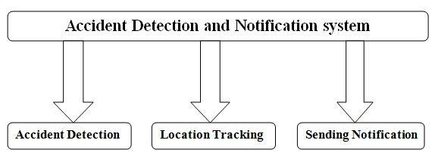
Proposed system

Slide 9
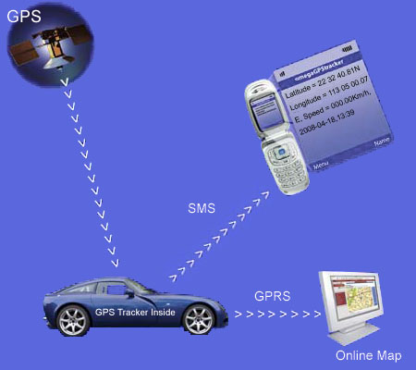
Working Principle
Whenever the vehicle meet with an accident an alert message will be sent to pre-coded contact number along with the current GPS location of vehicle. Global Positioning System (GPS) is used to identify the location of the vehicle. GSM is used to inform the exact vehicular location to the pre-coded numbers. Message will give longitude and latitude values.

Slide 10
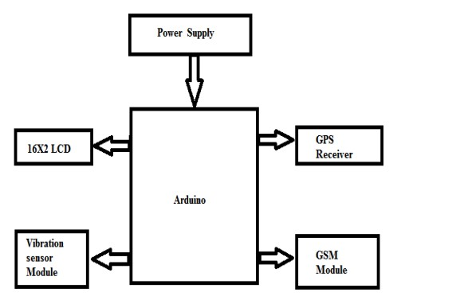
Block Diagram:

Slide 11
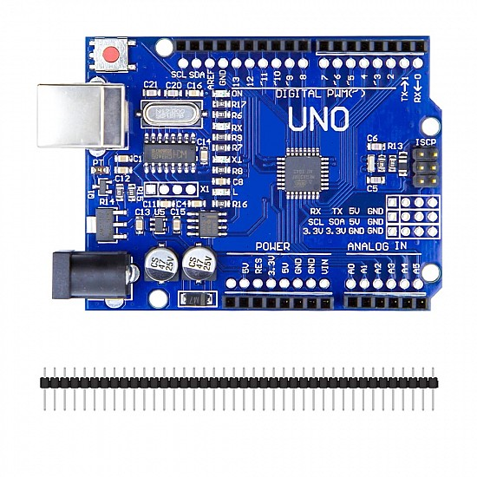
Arduino UNO
The code for the working of our proposed work will be dumped to the Arduino board through the USB cable.
The GPS module, GSM module, limit switch, relay, are connected to the Arduino board.

Slide 12
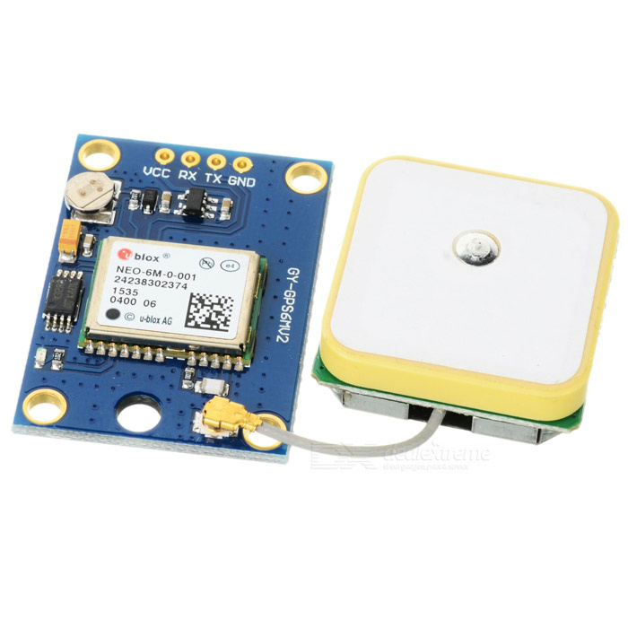
GPS module
The GPS antenna repeatedly collects the location of the vehicle and the GPS module continuously sends the location of the vehicle in terms of latitude and longitude to the Arduino.

Slide 13
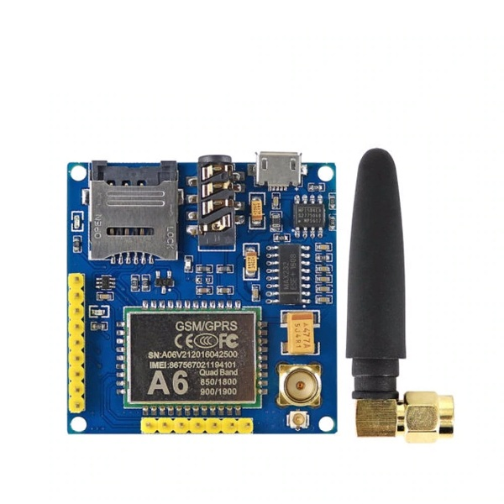
GSM module:
The GSM module is programmed in such a way that when the latitude and longitude from the GPS module is sent by the Arduino to the GSM module, it will be able to send that particular latitude and longitude to the pre-coded number in the form of an SMS

Slide 14
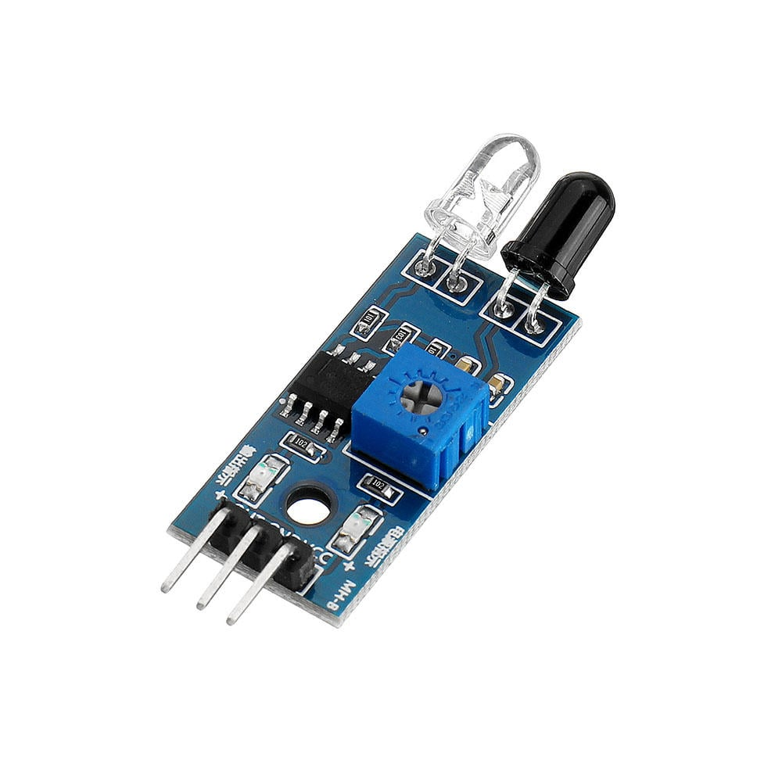
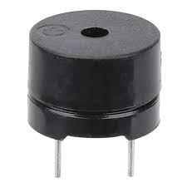
Speed Sensor:
It is a device used to measure the speed of wheel rotation of a vehicle. The speed sensor was initially used to replace the mechanical connection between the rotating wheels and the speedometer, reducing the use of cables and facilitating construction by reducing rotating parts.

Slide 15
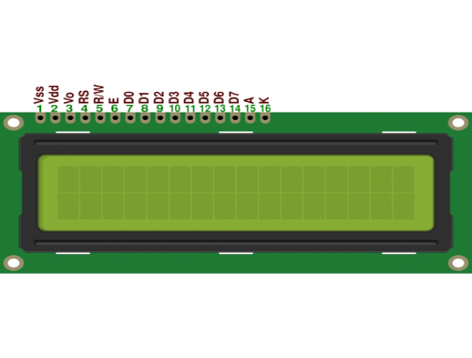
LCD Display:
LCD is a combination of two states of matter, the solid and the liquid. The solid part is crystal and this liquid and crystal together make the visible image. LCD consists of two layers which are two polarized panels- filters and electrodes. LCD screen works by blocking the light rather than emitting the light.

Slide 16
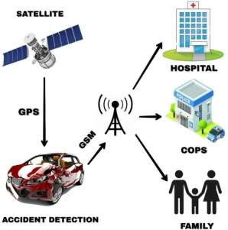
Signal Flow Diagram:

Slide 17

Software Description:
Software Description
Arduino IDE:
The Arduino (IDE) Software -contains a text editor for writing code, amessage area, a text console, a toolbar with buttons for commonfunctions and a series of menus. It connects to the Arduino andGenuino hardware to upload programs and communicate with them.
The Arduino (IDE) Software -contains a text editor for writing code, a message area, a text console, a toolbar with buttons for common functions and a series of menus. It connects to the Arduino hardware to upload programs and communicate with them.

Slide 18

Advantages:
It is easy to detect the exact location of the vehicle.
It will help to provide emergency responders with crucial information at the earliest possible time.
Simple to install and operate.

Slide 19

Applications:
Used in automotives and transport vehicles- from lighter vehicles like cars, to heavier automotives like ships and aero-planes.
This system is also can be interfaced with Vehicle airbag system such that when the sensors detect the accident, the air bags get opened.
School transport vehicle accident detection.
This project can be used for cab or car of companies.

Slide 20
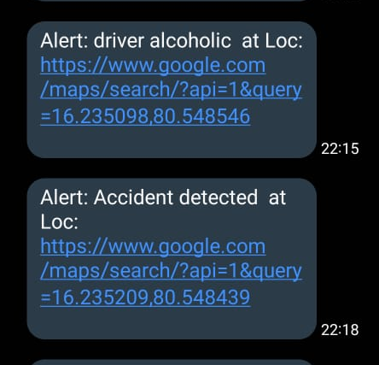
Result
The system detects accident from vehicle and send message through GSM module. The message is received by another GSM module. Google Map Module It displays Google map show you exact location of accident and it details. It gets detail SMS from accident location. Hence there is small variation in the coordinates, initial value of latitude and longitude are same but fractional value changes with small difference.

Slide 21
References
Md.syedul amin, Reaz, “Accident Detection and reporting system using GPS,GSM technology”.
Souvik roy, Akanksha kumari, Pulakesh roy, Rajib Banerjee. “Accident Detection and location communication system”.
Kh.azizul hakim, md.mehedi hasan, surma akter, “ Accident Detection and messaging system using GSM and GPS module”.

Slide 22



